Slide 1


Attention Please!
“Any sufficiently advanced technology is indistinguishable from magic.”
Attention Mechanisms in Neural Networks
Patrick Michl <patrick.michl@gmail.com>
2022-06-23

Slide 2
Attention Please!
“Any sufficiently advanced technology is indistinguishable from magic.”
Arthur C. Clarke in Profiles of the Future (1962)
Attention Mechanisms in Neural Networks
Patrick Michl <patrick.michl@gmail.com>
2022-06-23

Slide 3
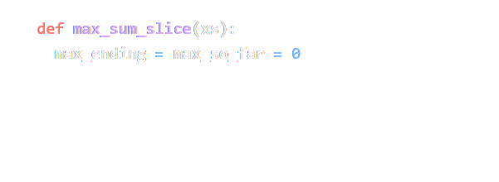

Attention Please!
“Any sufficiently advanced technology is indistinguishable from magic.”
Arthur C. Clarke in Profiles of the Future (1962)
Attention Mechanisms in Neural Networks
Patrick Michl <patrick.michl@gmail.com>
2022-06-23

Slide 4
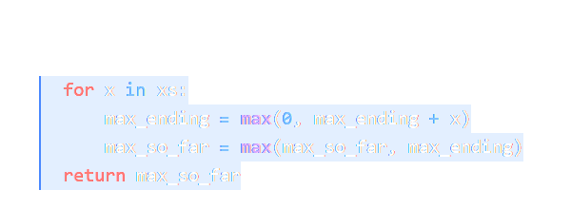
Attention Please!
“Any sufficiently advanced technology is indistinguishable from magic.”
Arthur C. Clarke in Profiles of the Future (1962)
Copilot from OpenAI / GitHub (2022)
Attention Mechanisms in Neural Networks
Patrick Michl <patrick.michl@gmail.com>
2022-06-23

Slide 5
Milestones in Attention Research
since 1990s
Visual Attention in Human Perception

Slide 6
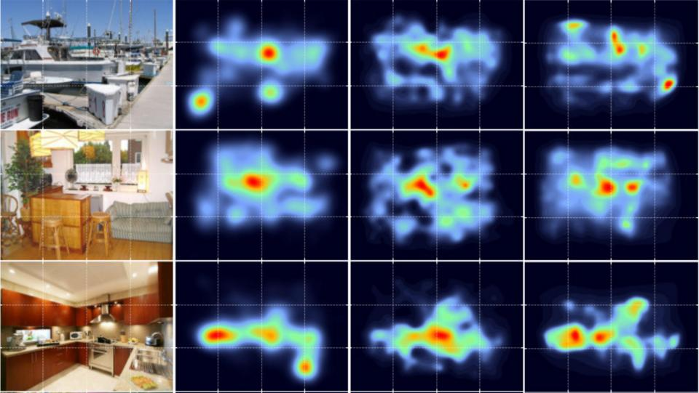
Visual Attention in Human Perception
Visual attention in human perception is based on selection and recognition
Image source: John Henderson and Taylor Hayes, UC Davis

Slide 7
Visual Attention in Image Captioning
since 1990s
since 2014
Visual Attention in Human Perception

Slide 8
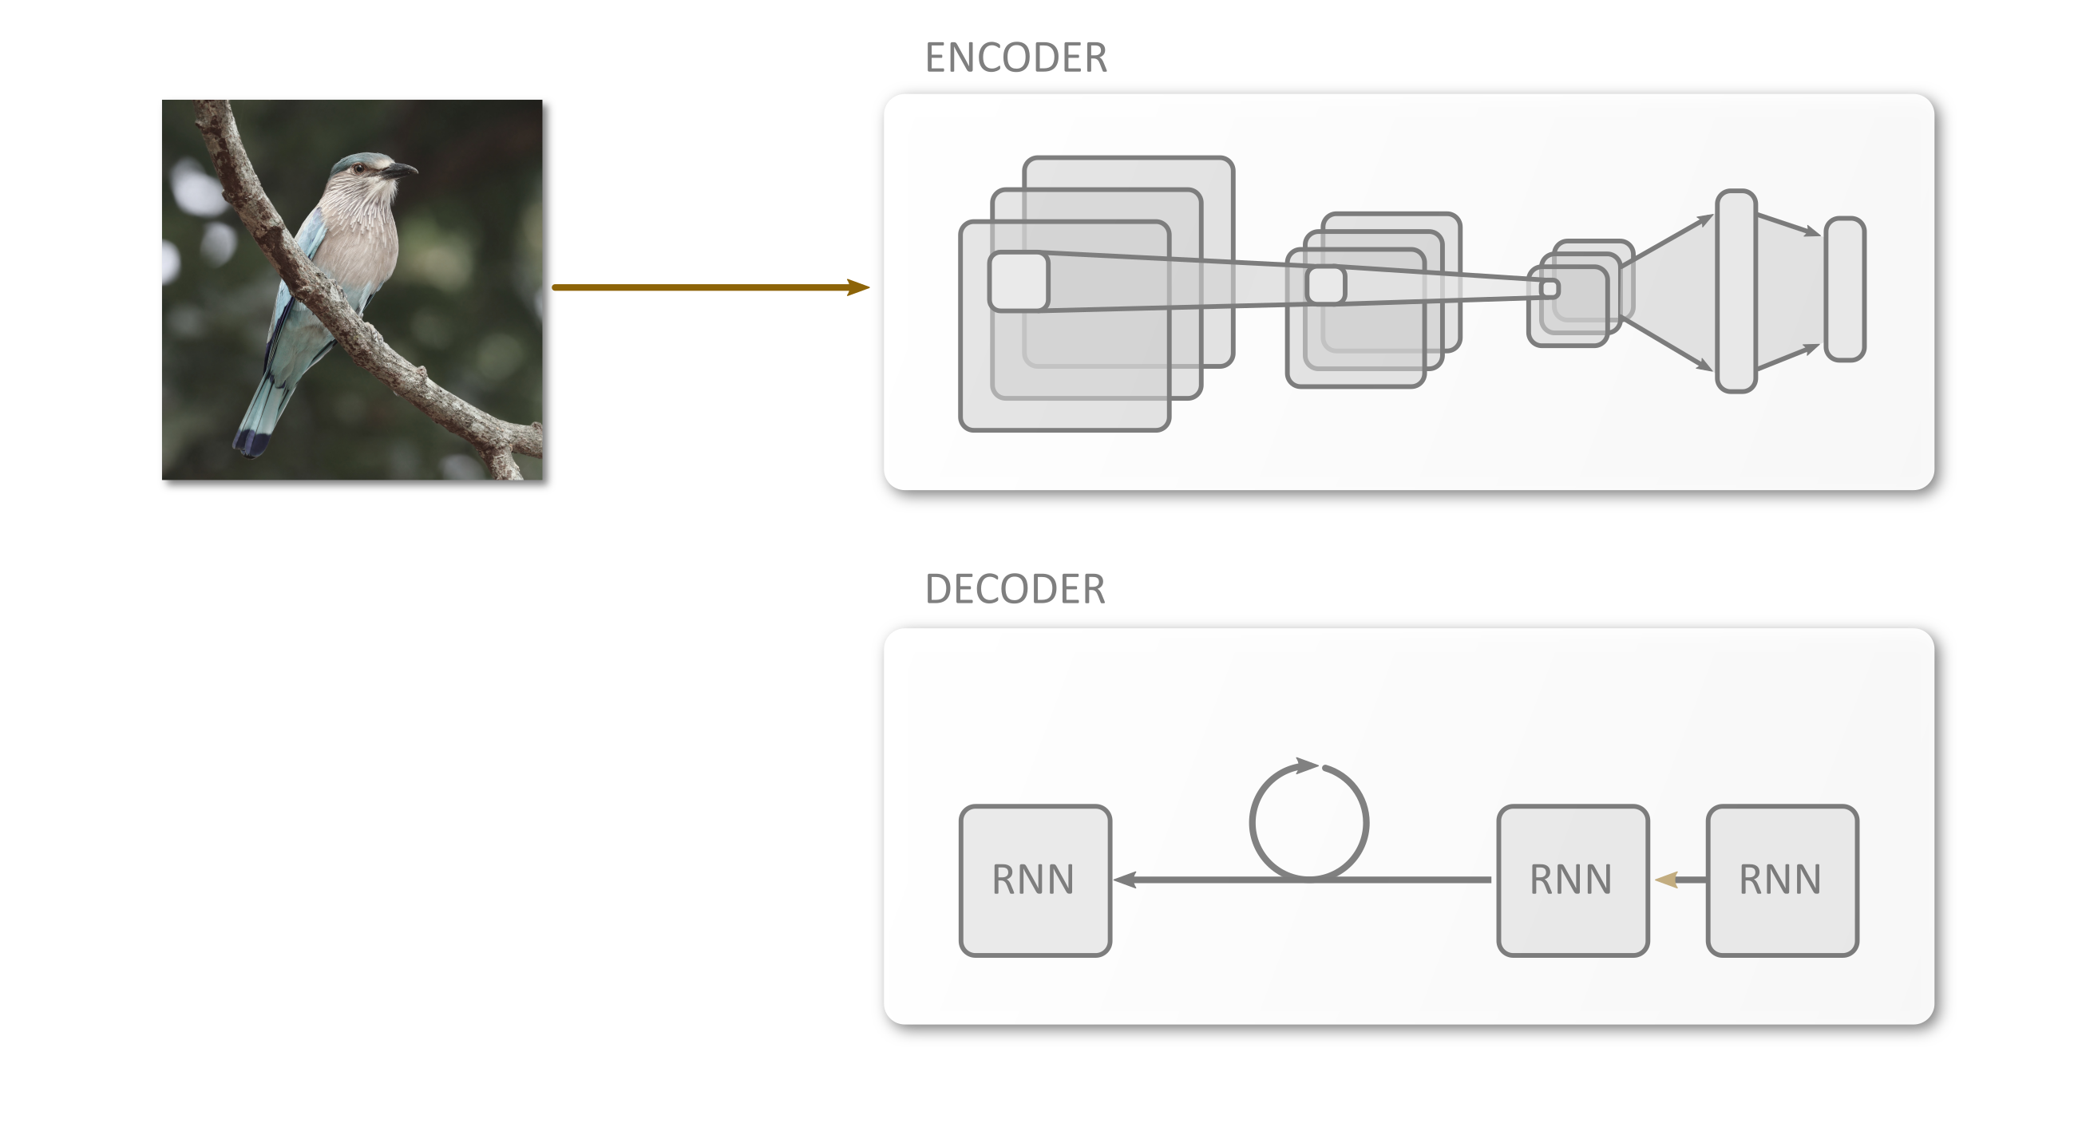
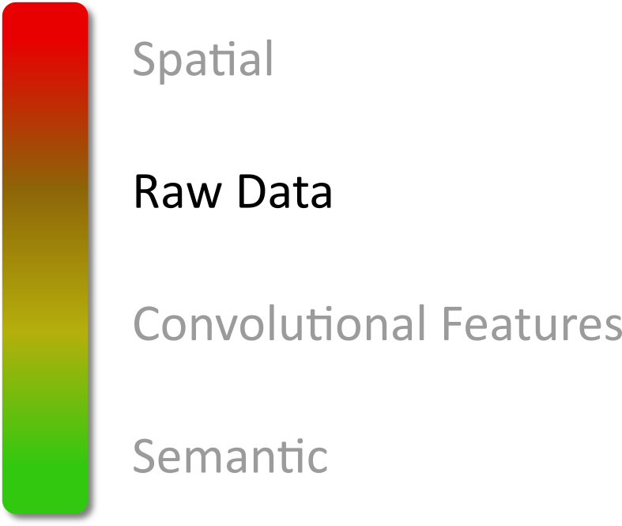
Visual Attention in Image Captioning

Slide 9
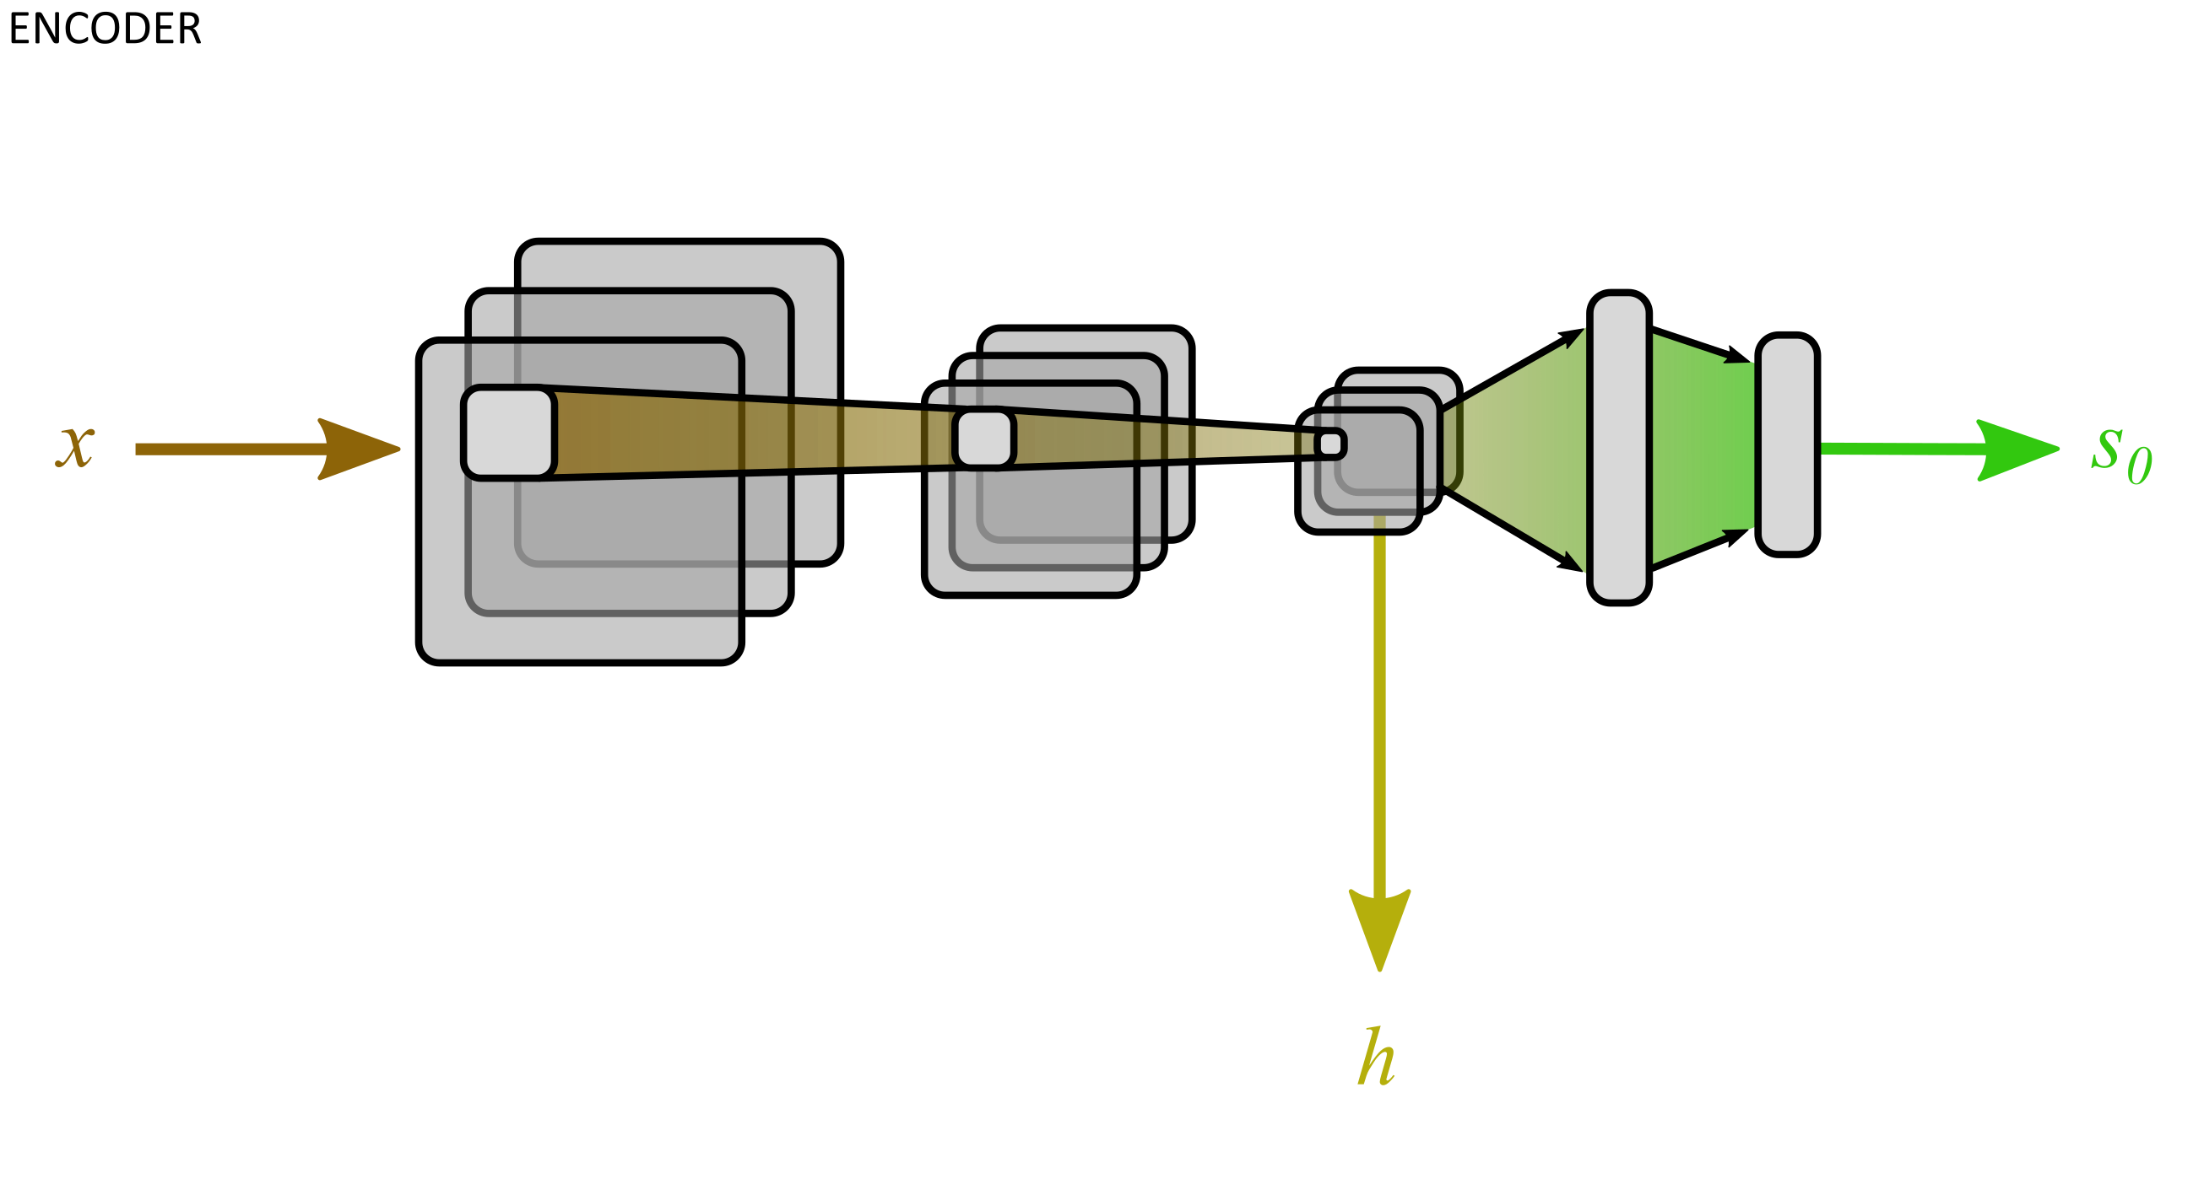
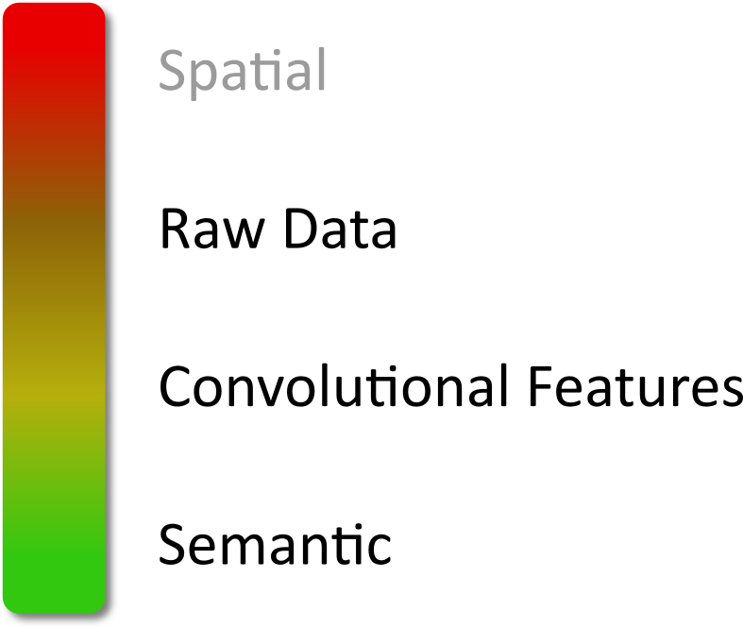
Visual Attention in Image Captioning

Slide 10
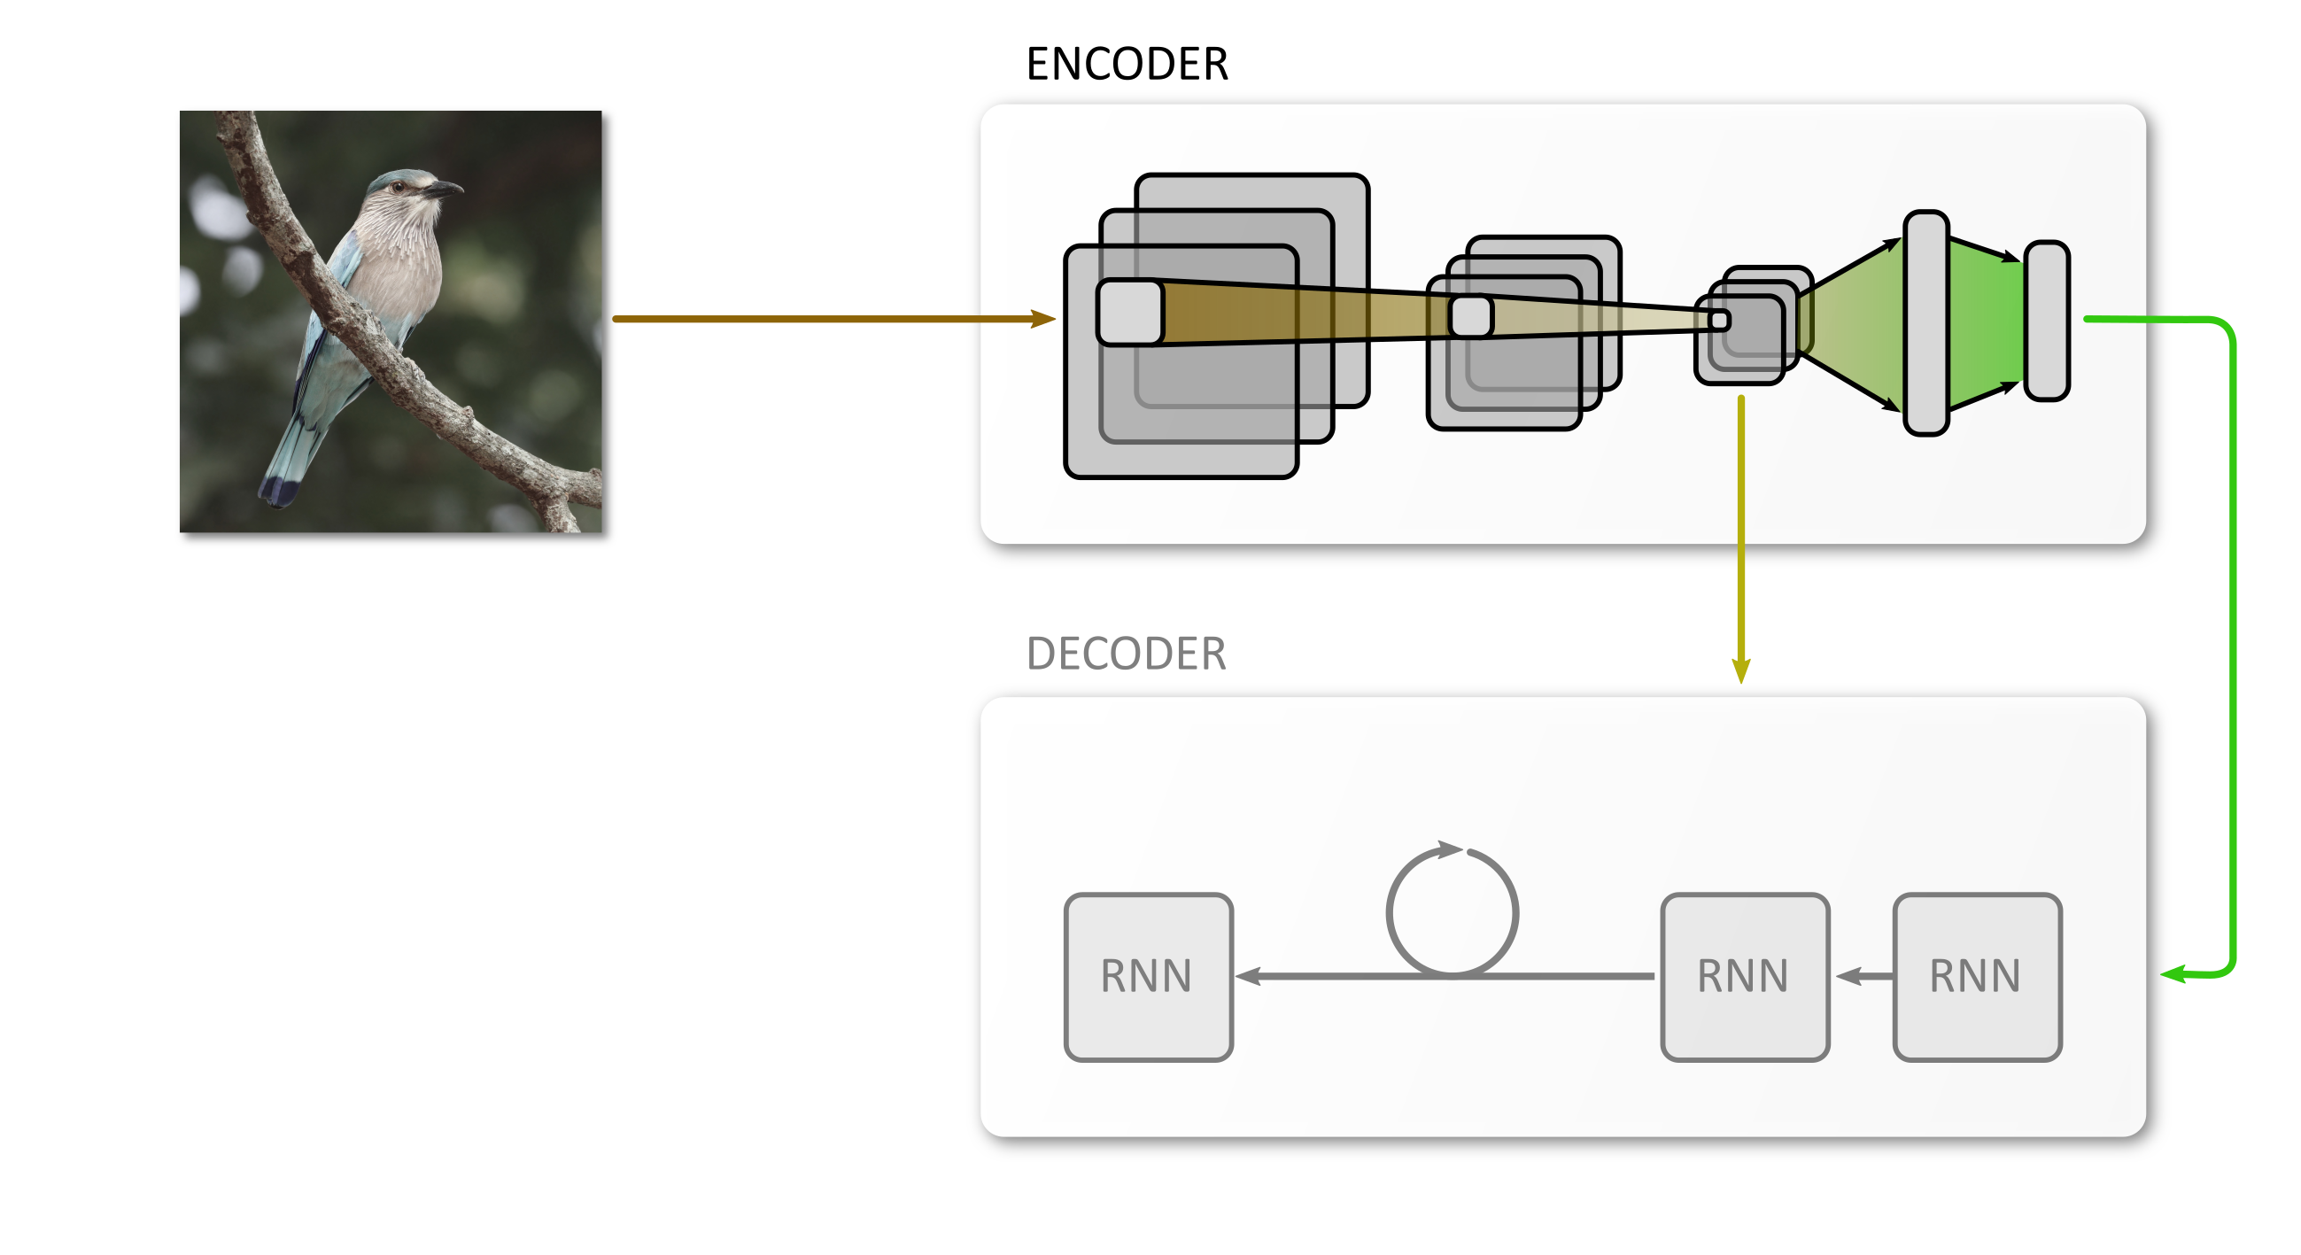
Visual Attention in Image Captioning

Slide 11
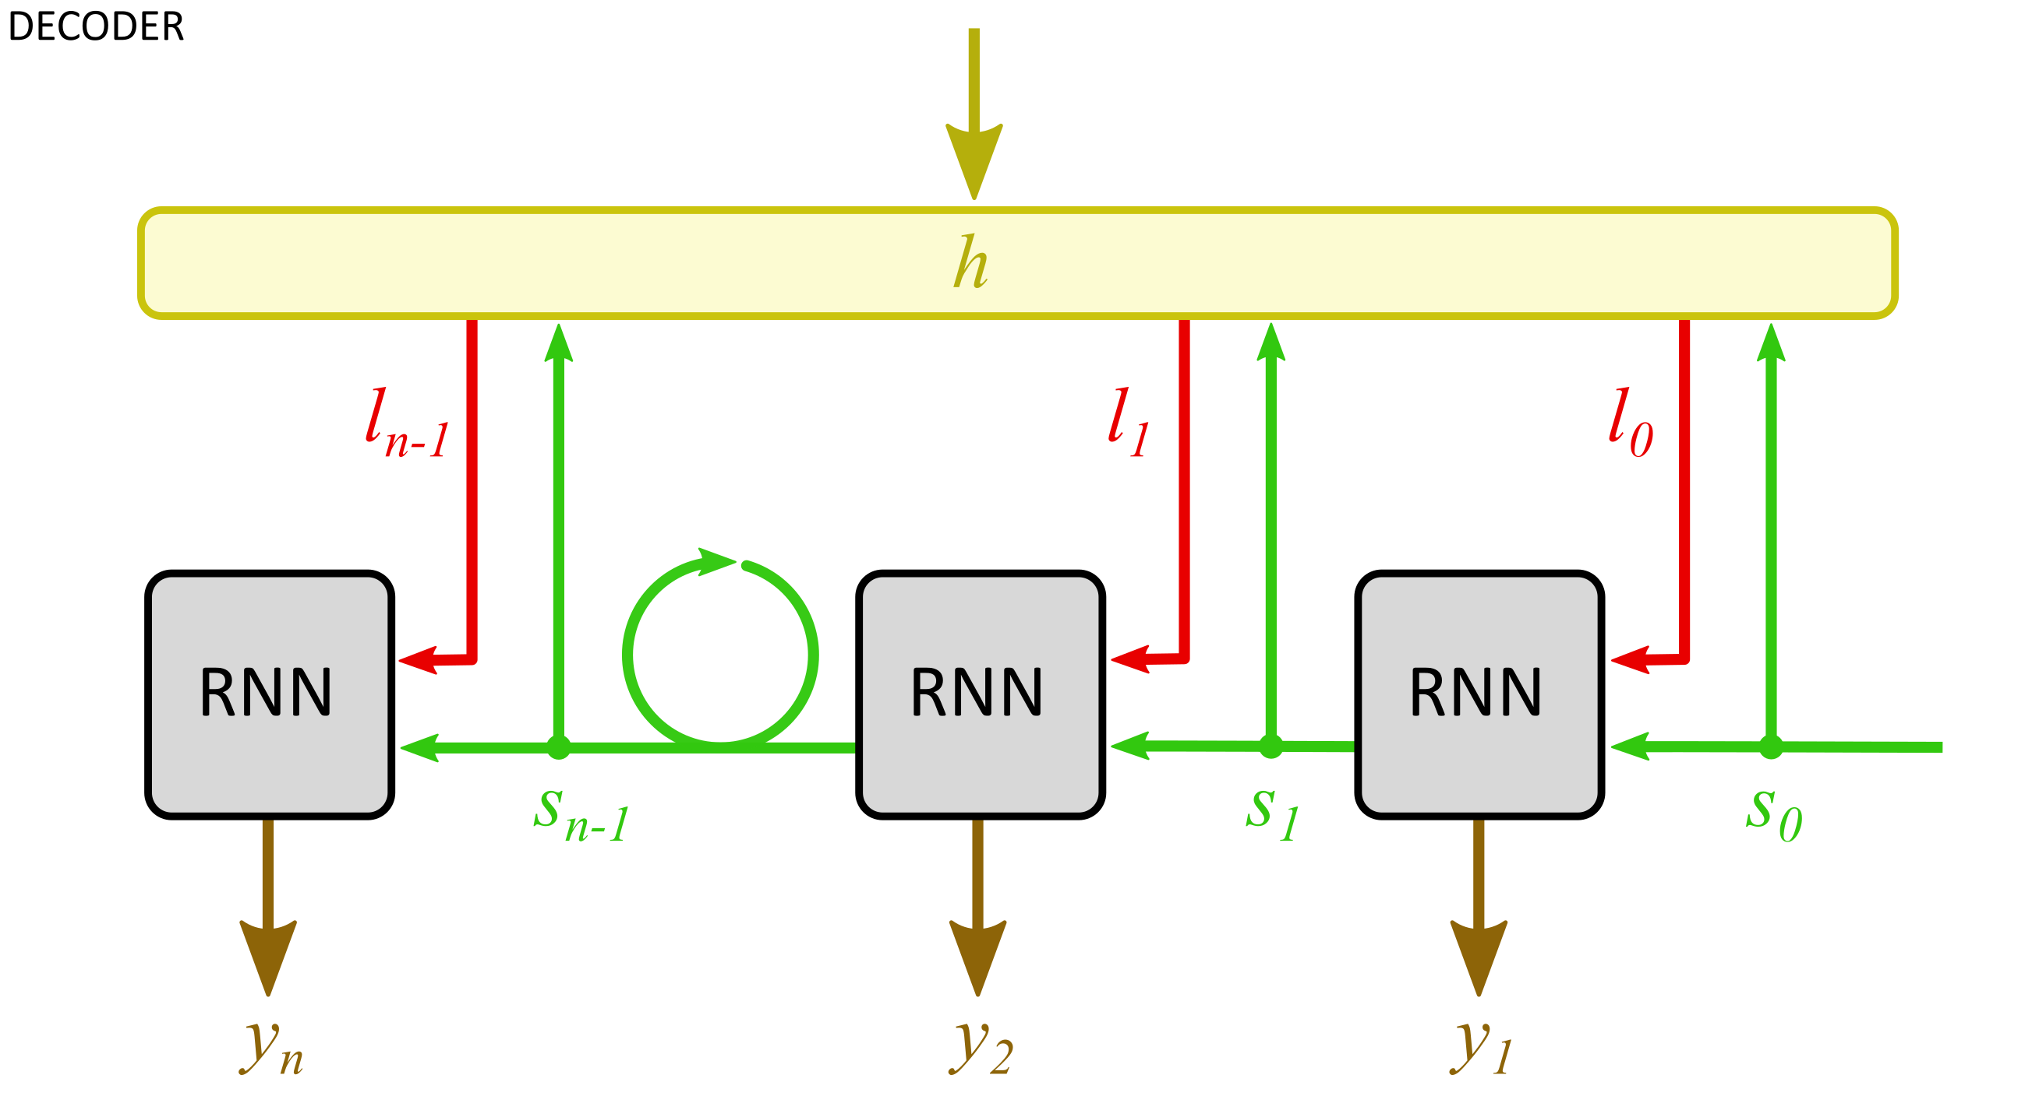
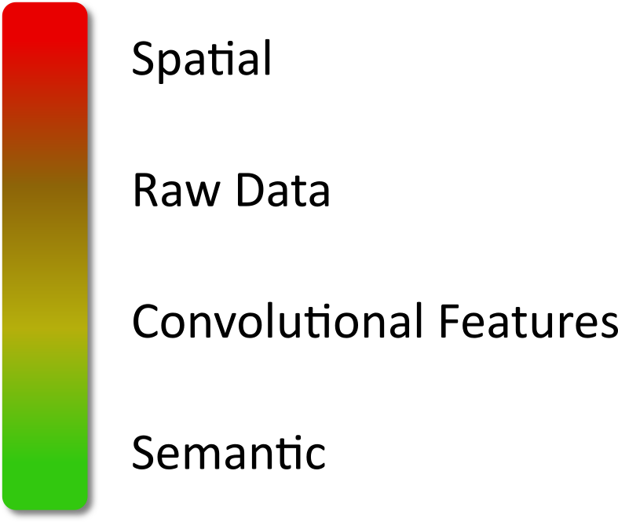
Visual Attention in Image Captioning

Slide 12
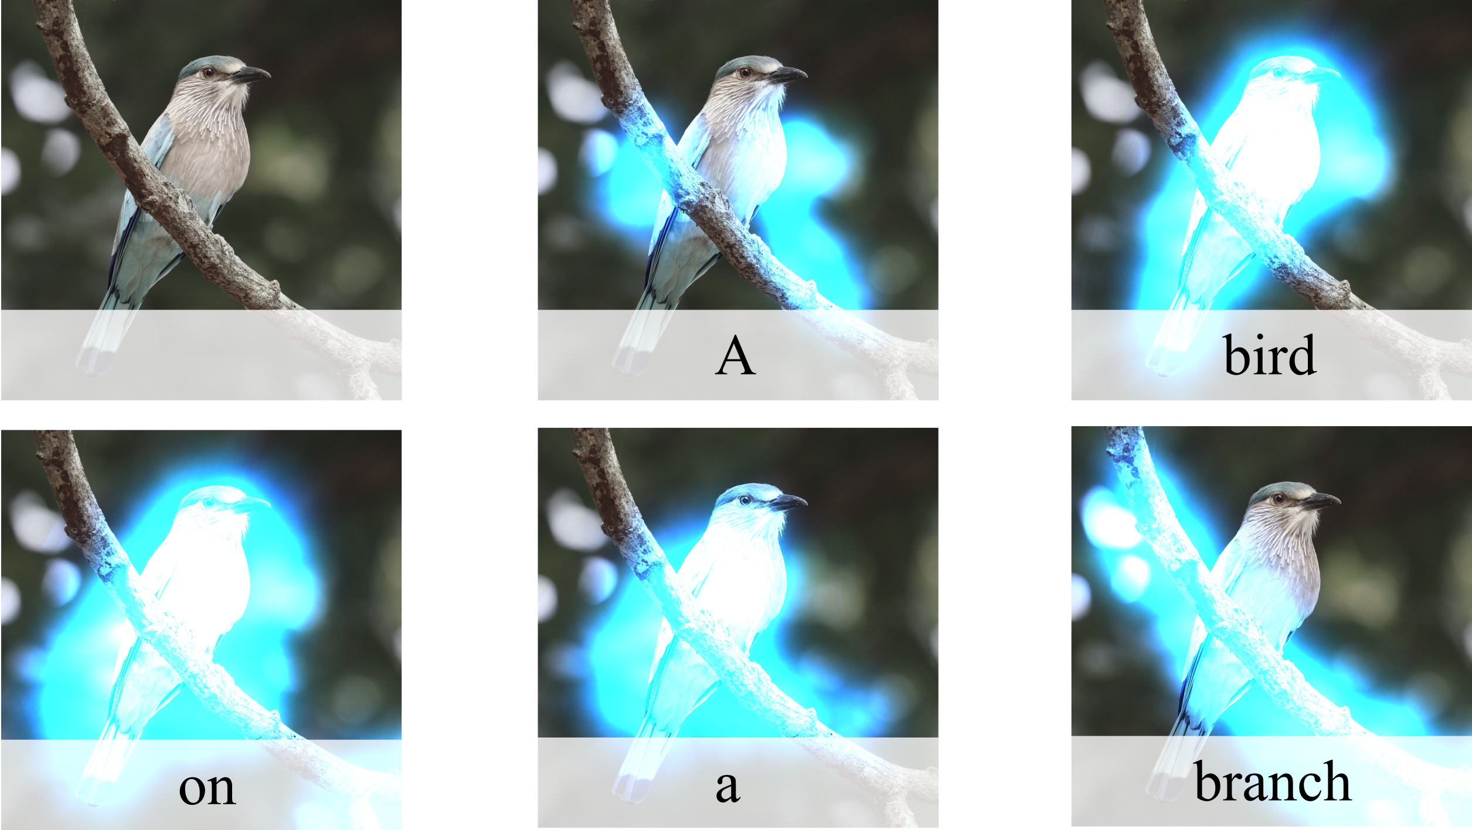
Visual Attention in Image Captioning

Slide 13
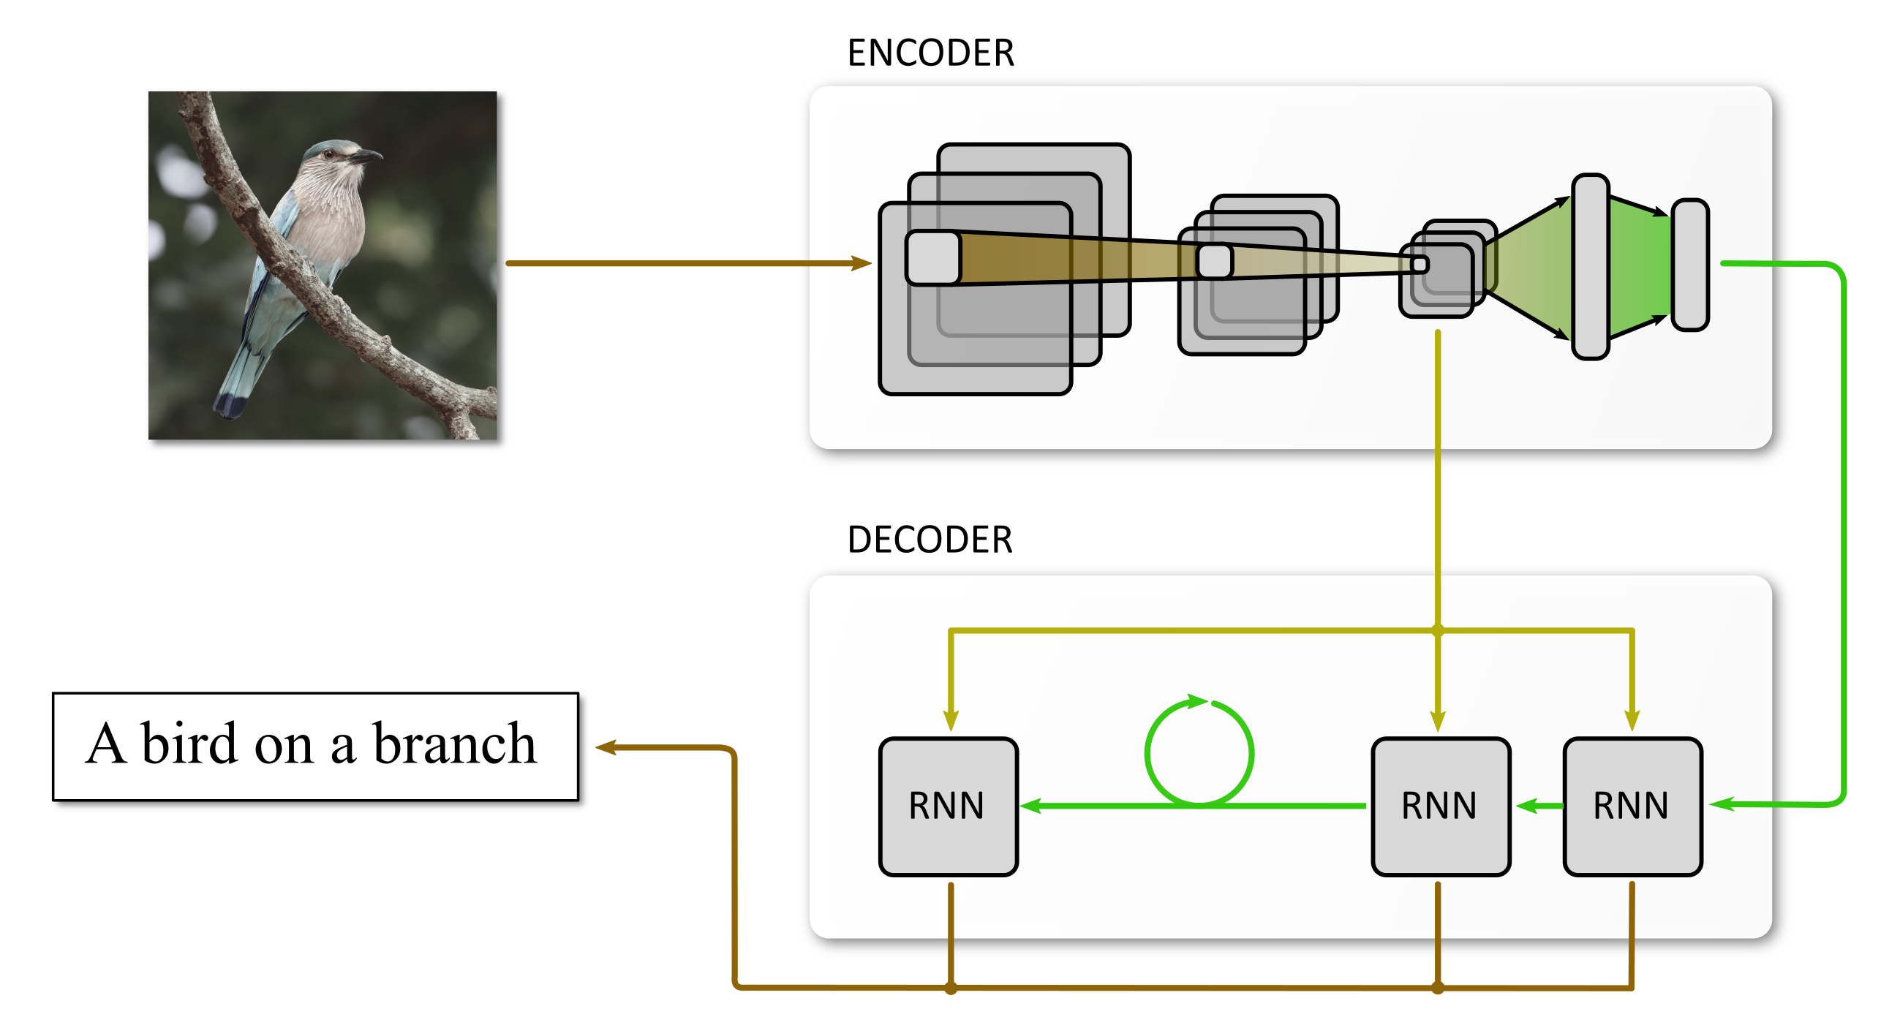
Visual Attention in Image Captioning

Slide 14
Visual Attention in Image Captioning
since 1990s
since 2014
since 2015
Visual Attention in Human Perception
Global Attention in Machine Translation

Slide 15
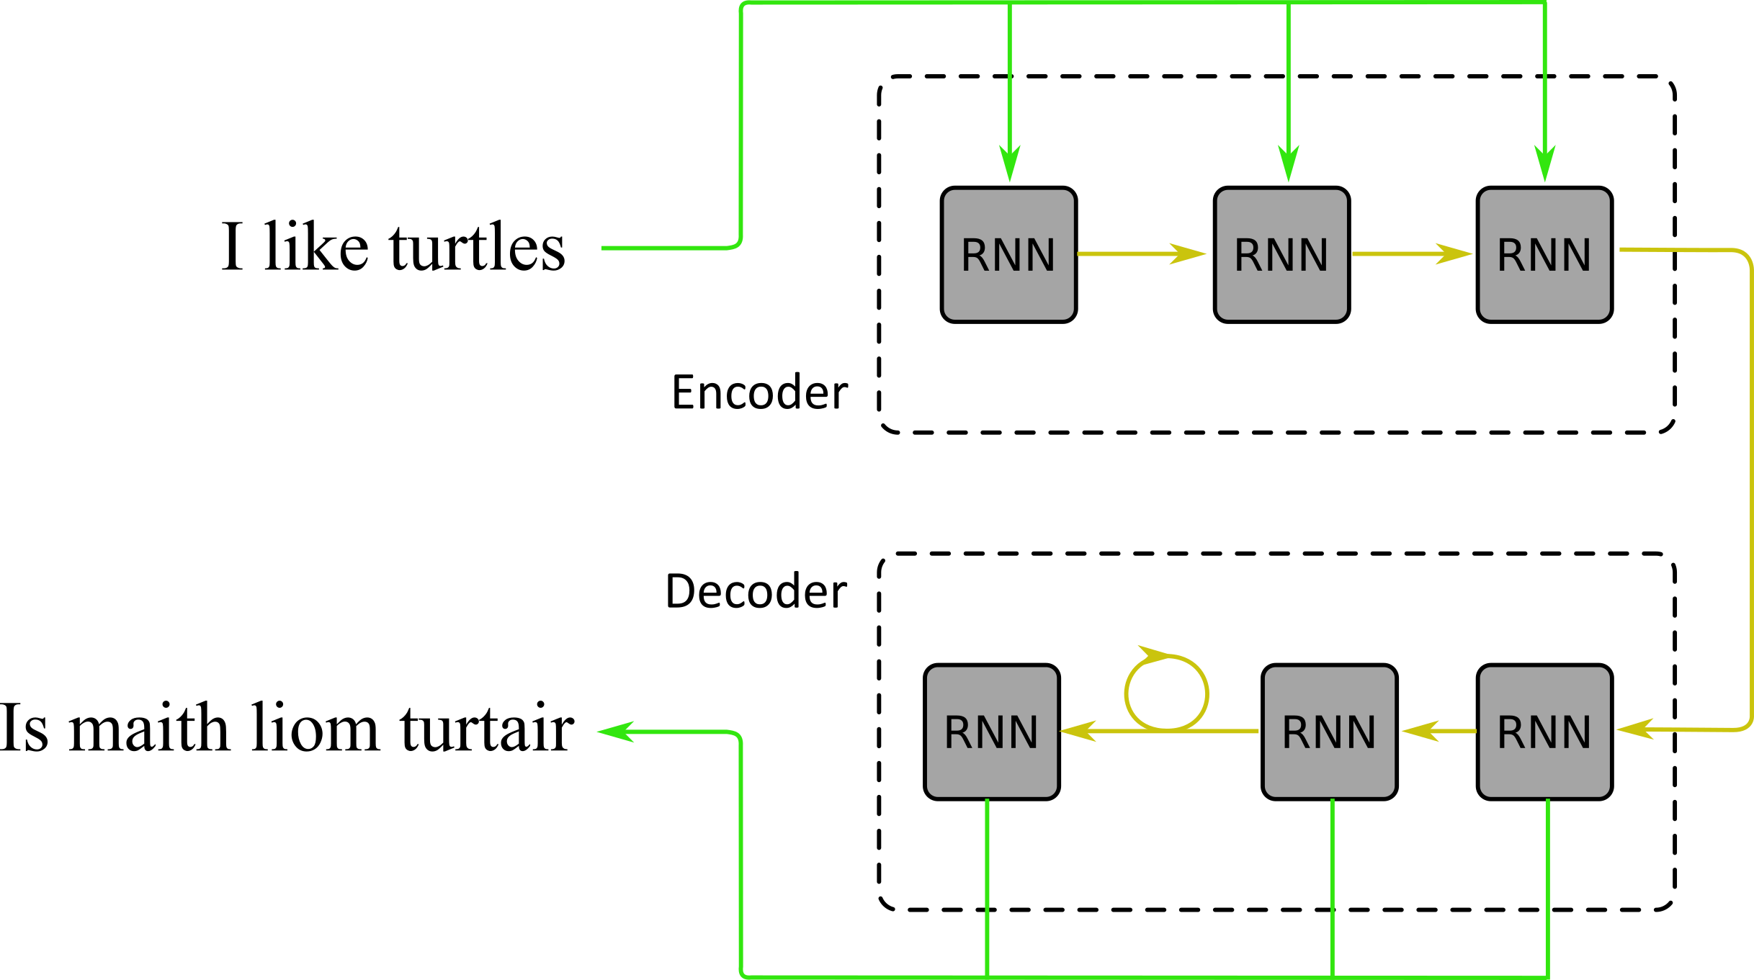
Global Attention in Machine Translation
Architecture
Encoder: RNN
Decoder: RNN

Slide 16
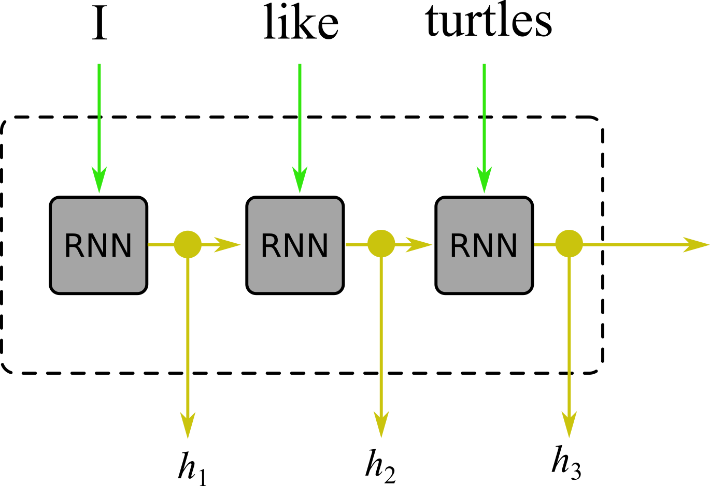
Global Attention in Machine Translation
Encoder
Encoder: RNN
Sequence of hidden states encodes the context building stack
Decoder: RNN

Slide 17
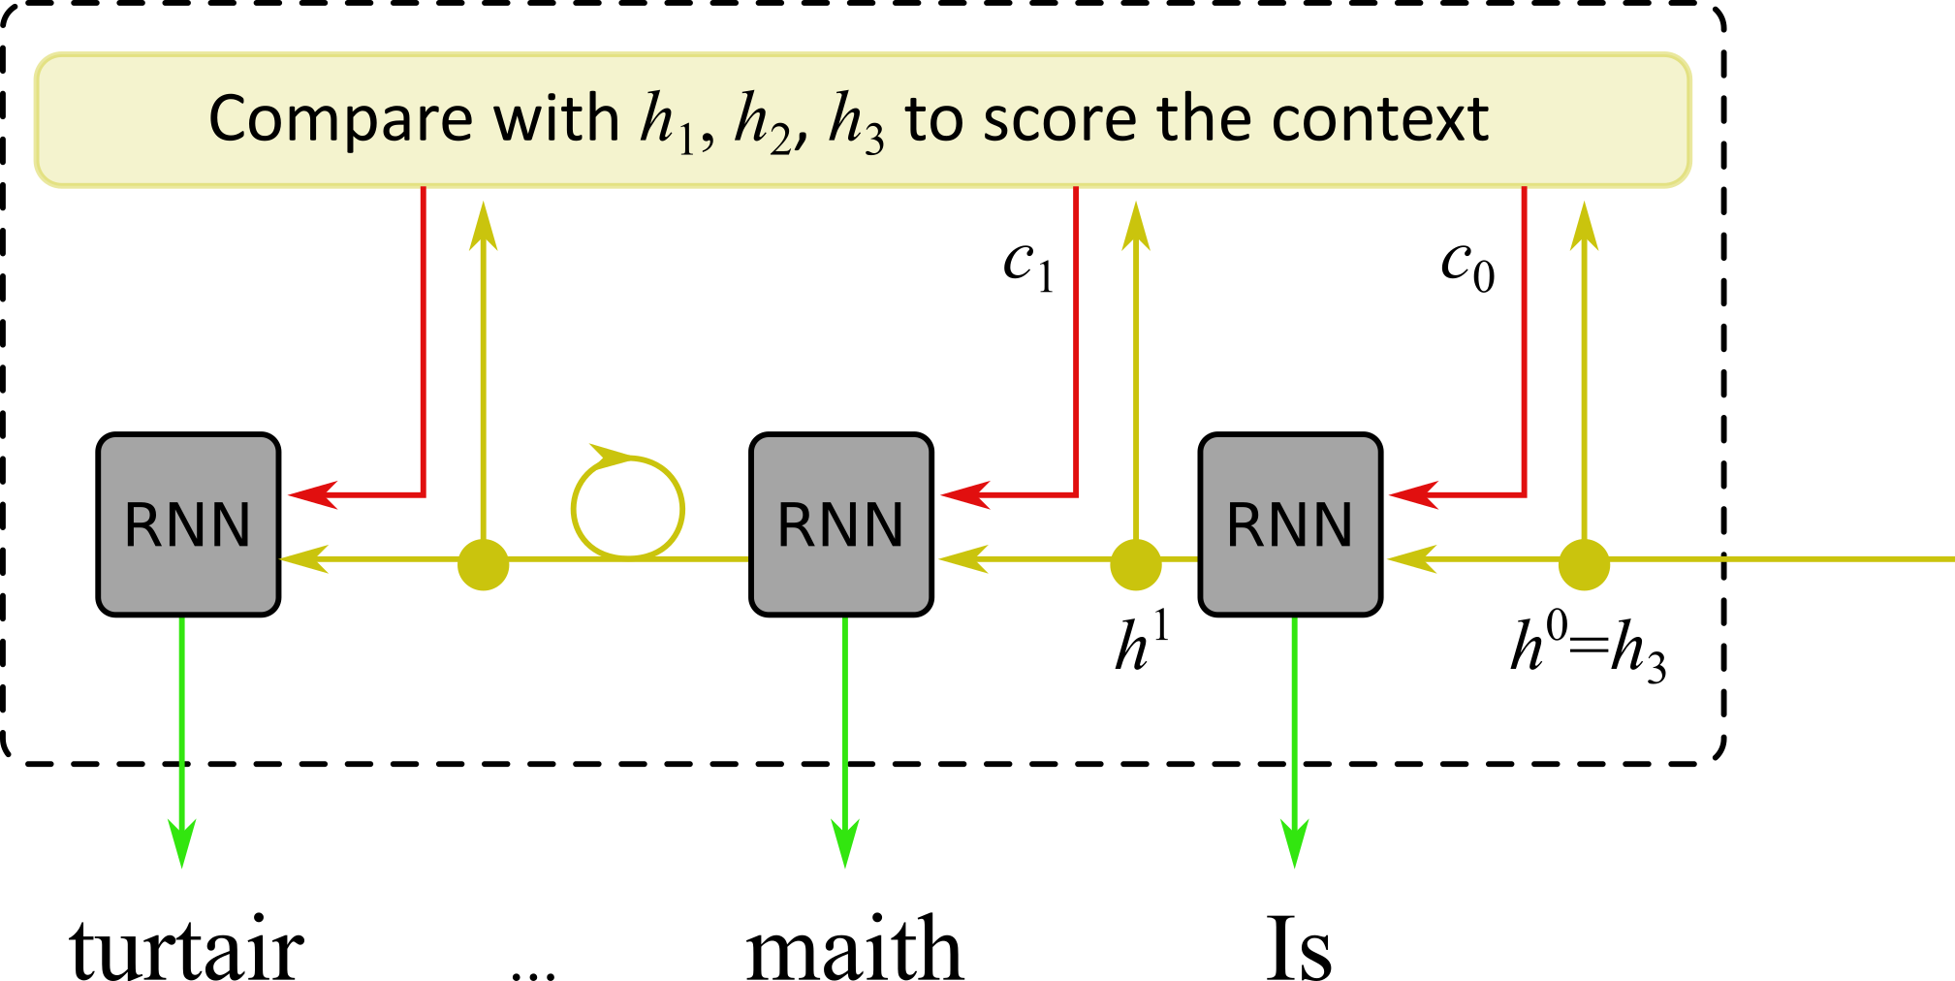
Global Attention in Machine Translation
Decoder
Encoder: RNN
Sequence of hidden states encodes the context building stack
Decoder: RNN
Global Attention allows to recover the context of current outputs

Slide 18
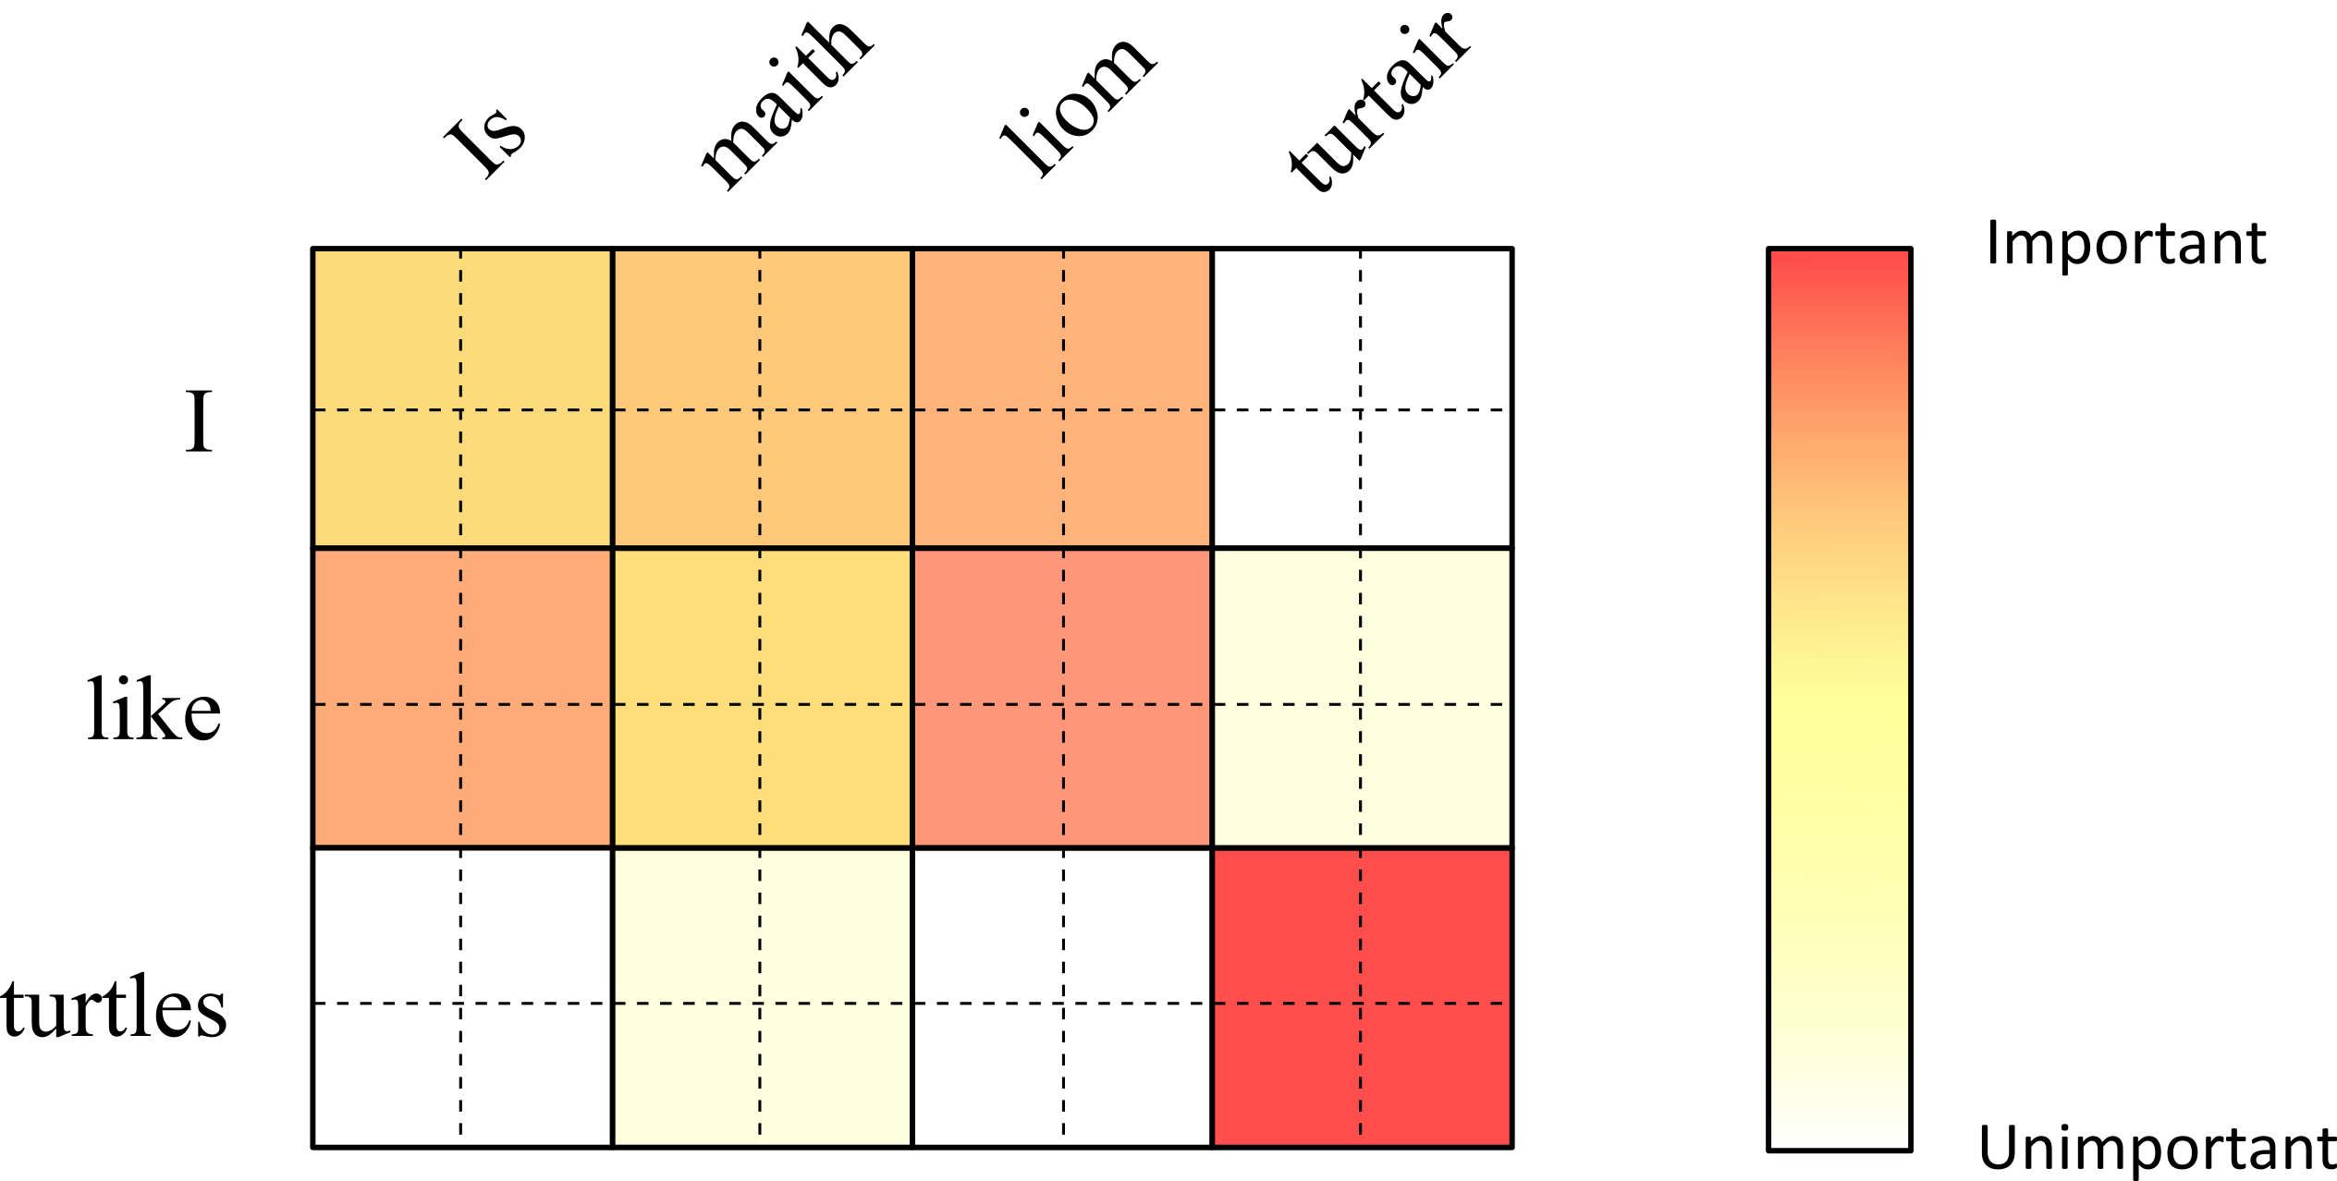
Global Attention in Machine Translation
Context
Encoder: RNN
Sequence of hidden states encodes the context building stack
Decoder: RNN
Global Attention allows to recover the context of current outputs

Slide 19
Visual Attention in Image Captioning
Multi-Step Attention in Natural Language Processing
since 1990s
since 2014
since 2015
since 2016
Visual Attention in Human Perception
Global Attention in Machine Translation

Slide 20
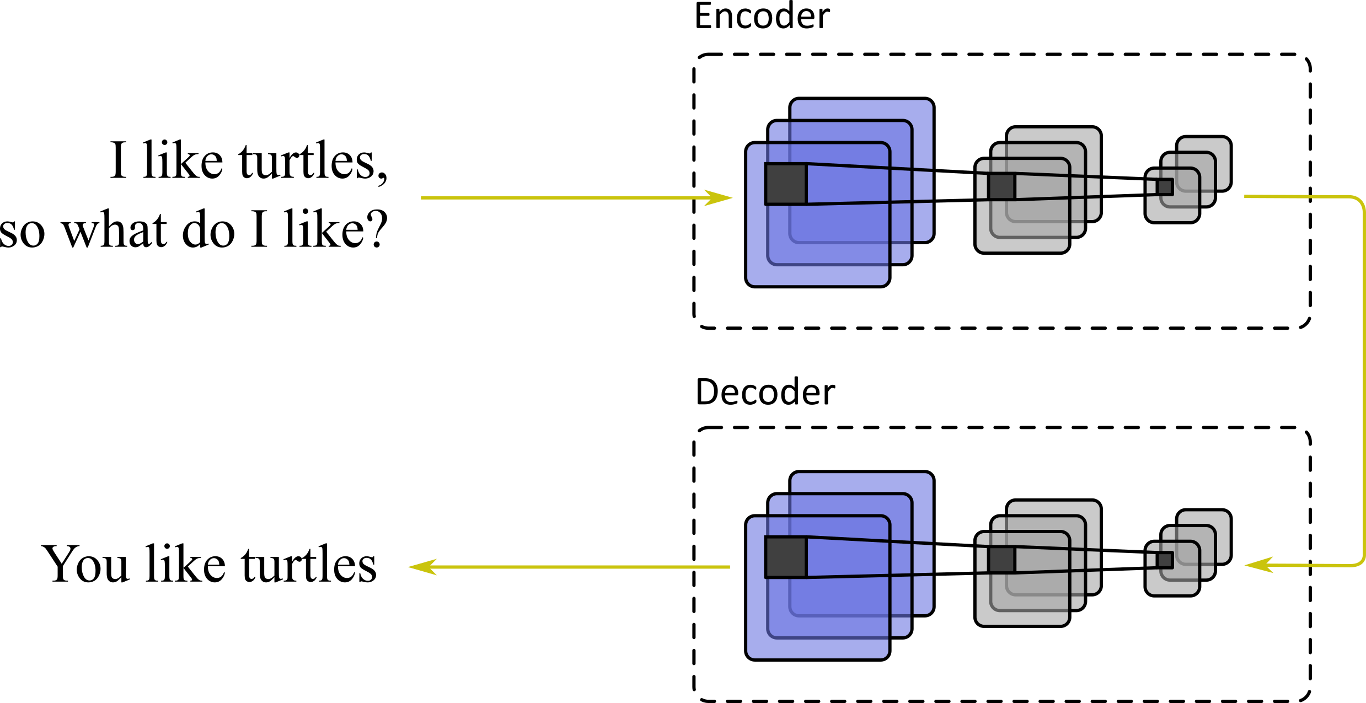
Multi-Step Attention in Natural Language Processing
Architecture
Encoder: CNN
Decoder: CNN

Slide 21
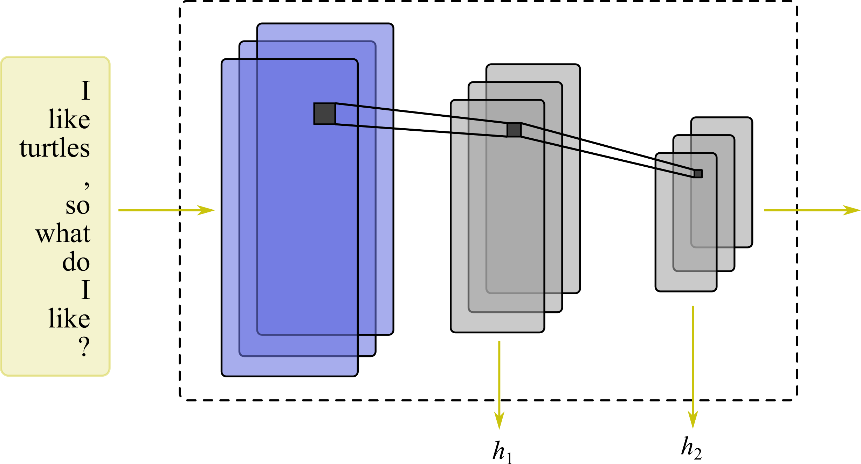
Multi-Step Attention in Natural Language Processing
Encoder
Encoder: CNN
Sequence of convolutional features encodes the context building stack
Decoder: CNN

Slide 22
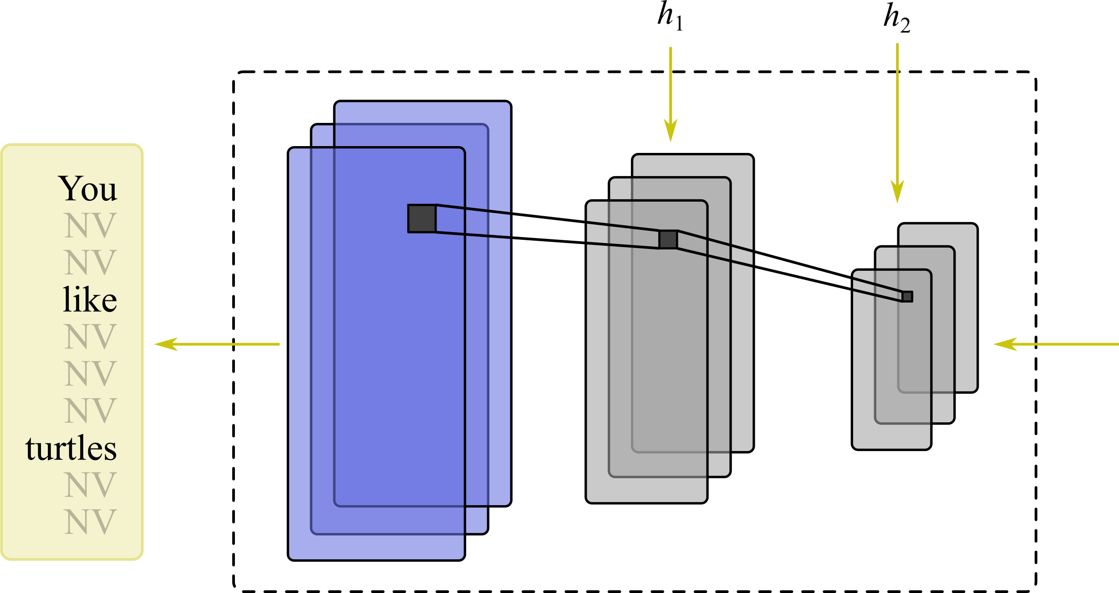
Multi-Step Attention in Natural Language Processing
Decoder
Encoder: CNN
Sequence of convolutional features encodes the context building stack
Decoder: CNN
Multi-Step Attention allows to recover the current context of current deconvolutional steps

Slide 23
Visual Attention in Image Captioning
Multi-Step Attention in Natural Language Processing
since 1990s
since 2014
since 2015
since 2016
since 2017
Visual Attention in Human Perception
Global Attention in Machine Translation
Self-Attention in Natural Language Processing

Slide 24
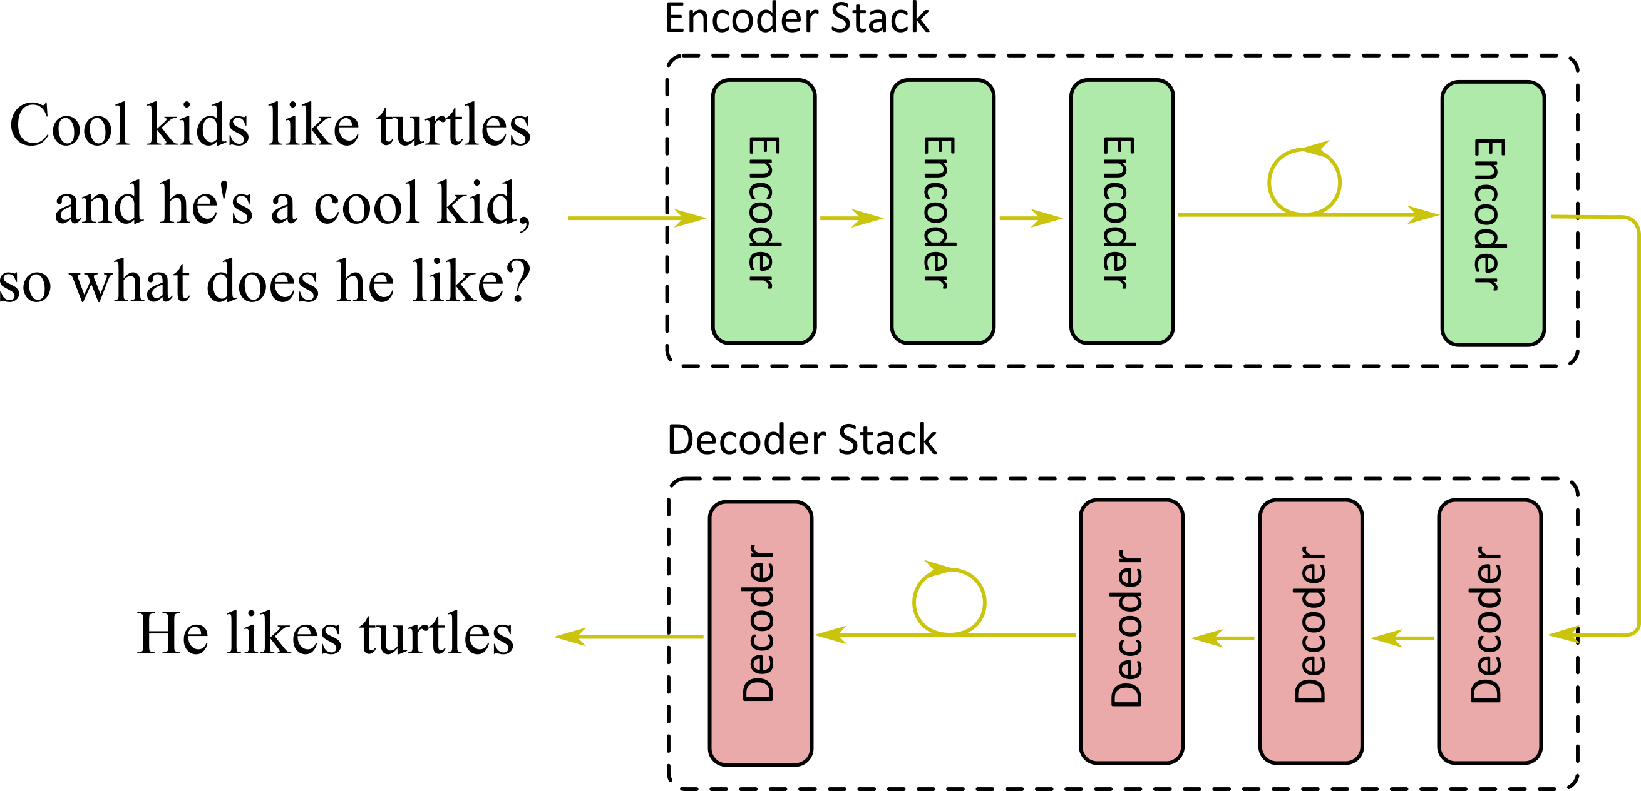
Self-Attention in Natural Language Processing
Architecture
Encoder: Stacked ANN
Decoder: Stacked ANN

Slide 25
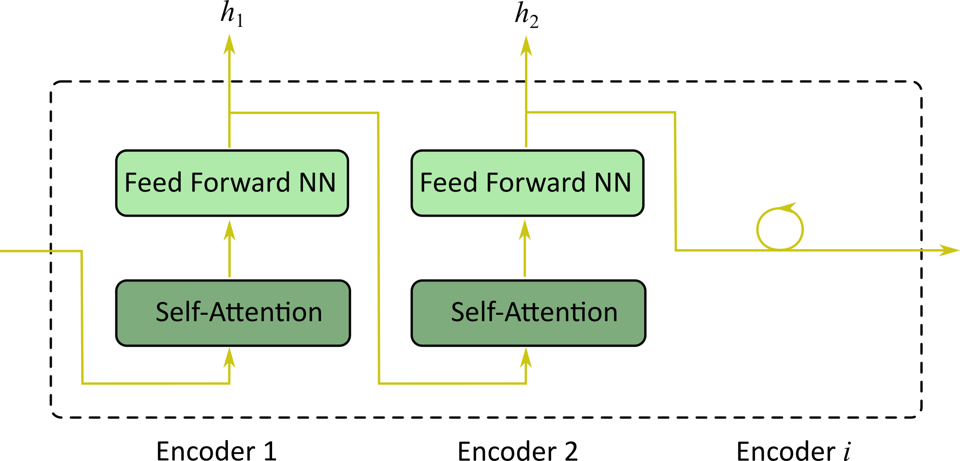
Self-Attention in Natural Language Processing
Encoder Stack
Encoder: Stacked ANN
Sequence of hidden features captures the encoder context building stack
Decoder: Stacked ANN

Slide 26
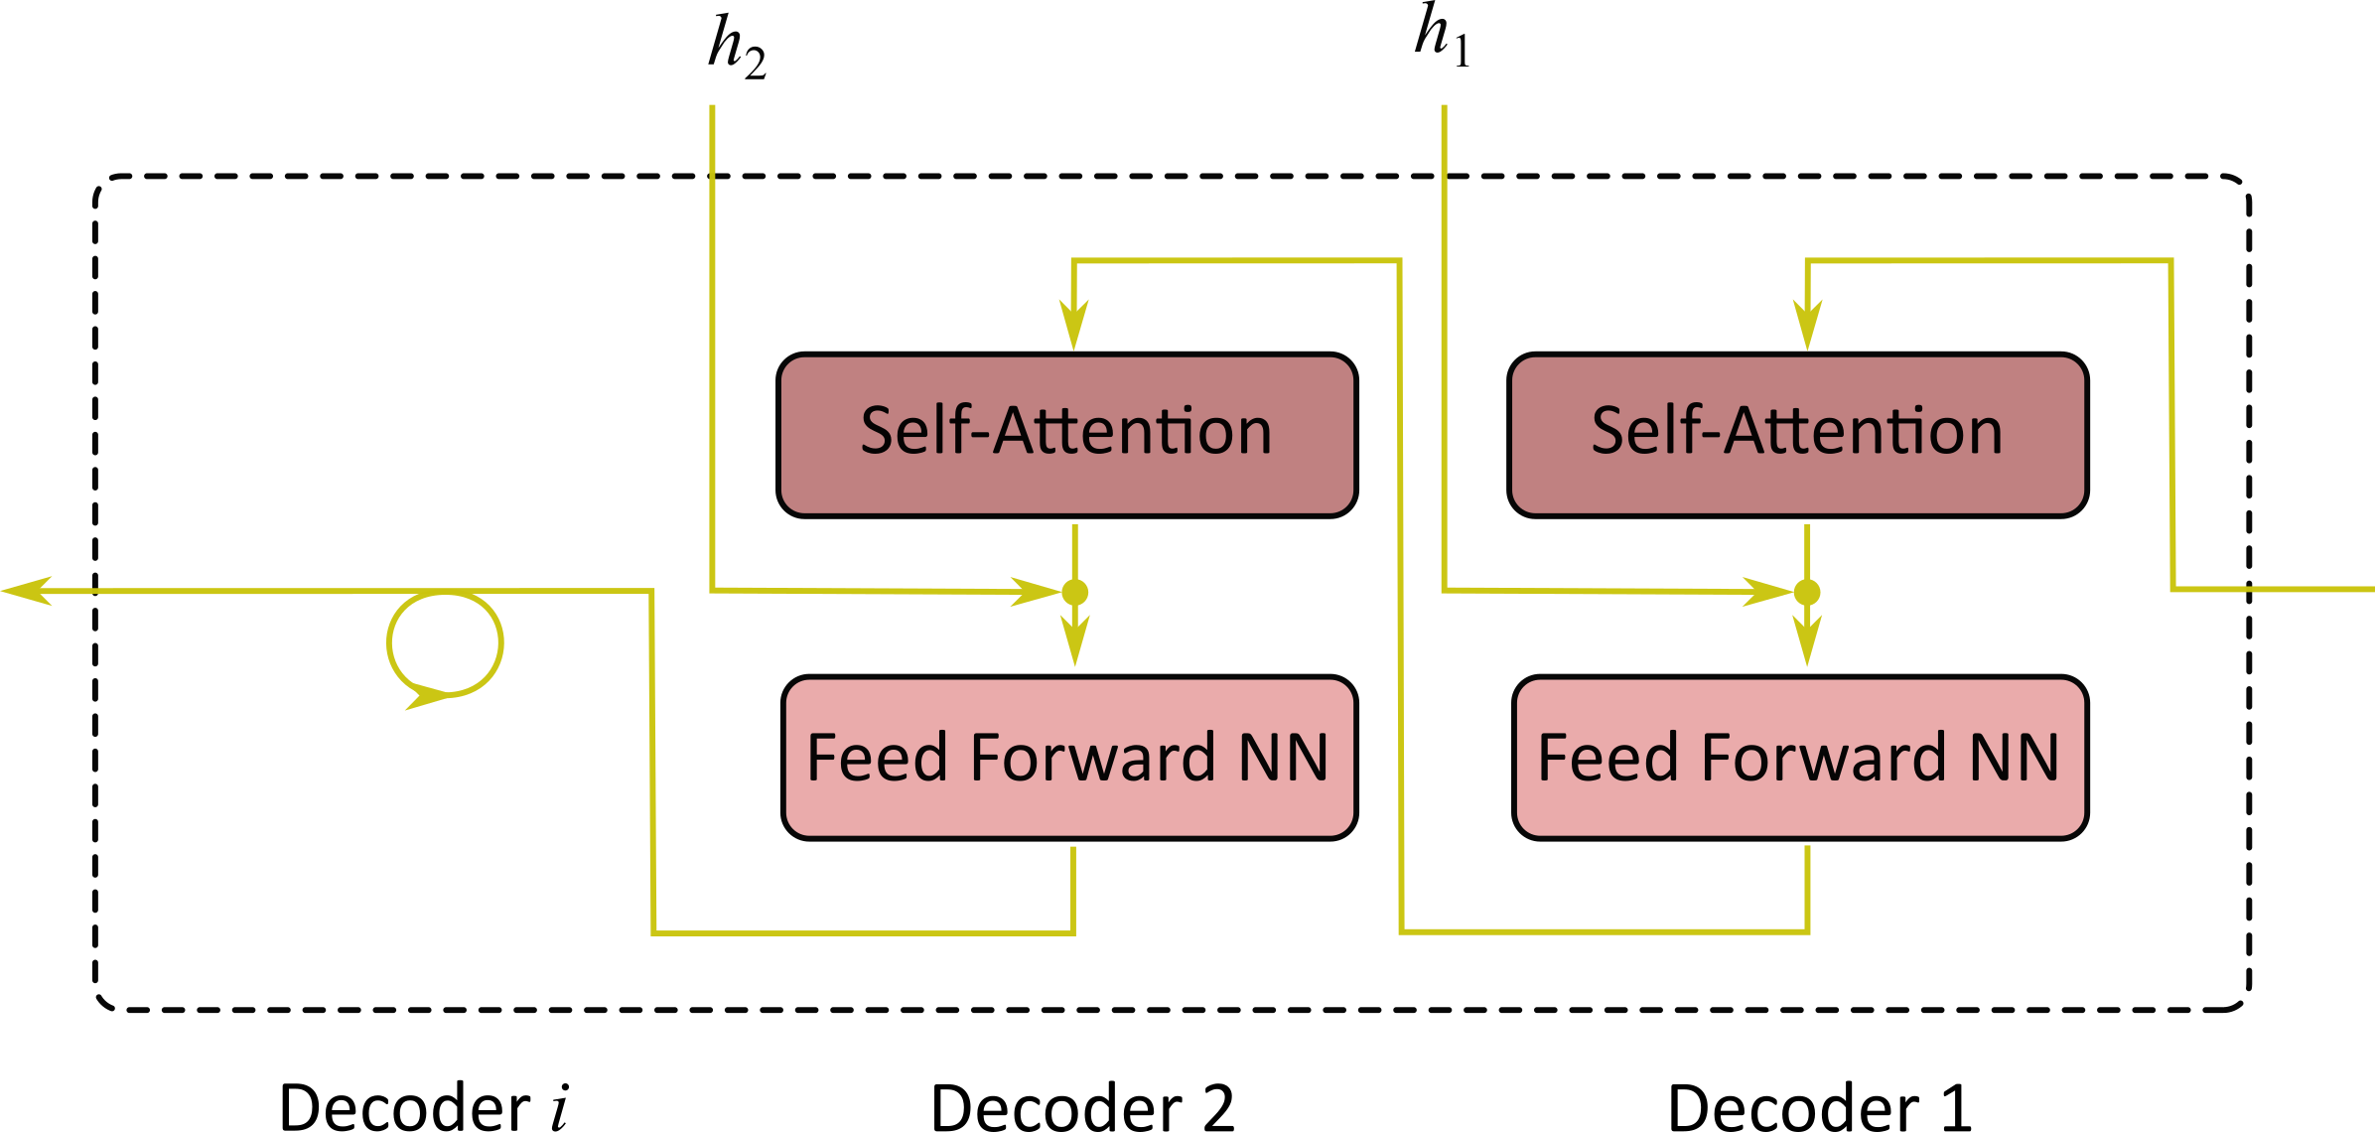
Self-Attention in Natural Language Processing
Decoder Stack
Encoder: Stacked ANN
Sequence of hidden features captures the encoder context building stack
Decoder: Stacked ANN
Multi-Step Attention unrolls the context stack to the decoder

Slide 27
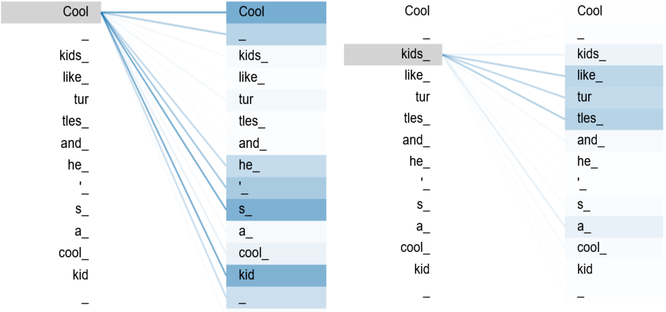
Self-Attention in Natural Language Processing
Self-Attention
Encoder: Stacked ANN
Sequence of hidden features captures the encoder context building stack
Decoder: Stacked ANN
Multi-Step Attention unrolls the context stack to the decoder
------ Self-attention aggregates context dependencies within the inputs

Slide 28
Summary
#1
Human Perception is based on the dynamics between selection and recognition
#3
The incorporation of context provides dynamic features that are context specific and therefore improve the model perfomance
#2
Attention machanisms immitate this behaviour by using intermediate states, that entangle context with semantic information
#4
After all - attention mechanisms can also help to understand the decisions of deep networks

Slide 29
Summary
#1
Human Perception is based on the dynamics between selection and recognition
#3
The incorporation of context provides dynamic features that are context specific and therefore improve the model perfomance
#2
Attention machanisms immitate this behaviour by using intermediate states, that entangle context with semantic information
#4
After all - attention mechanisms can also help to understand the decisions of deep networks

Slide 30
Summary
#1
Human Perception is based on the dynamics between selection and recognition
#3
The incorporation of context provides dynamic features that are context specific and therefore improve the model perfomance
#2
Attention machanisms immitate this behaviour by using intermediate states, that entangle context with semantic information
#4
After all - attention mechanisms can also help to understand the decisions of deep networks

Slide 31
Summary
#1
Human Perception is based on the dynamics between selection and recognition
#3
The incorporation of context provides dynamic features that are context specific and therefore improve the model perfomance
#2
Attention machanisms immitate this behaviour by using intermediate states, that entangle context with semantic information
#4
After all - attention mechanisms can also help to understand the decisions of deep networks

Slide 32
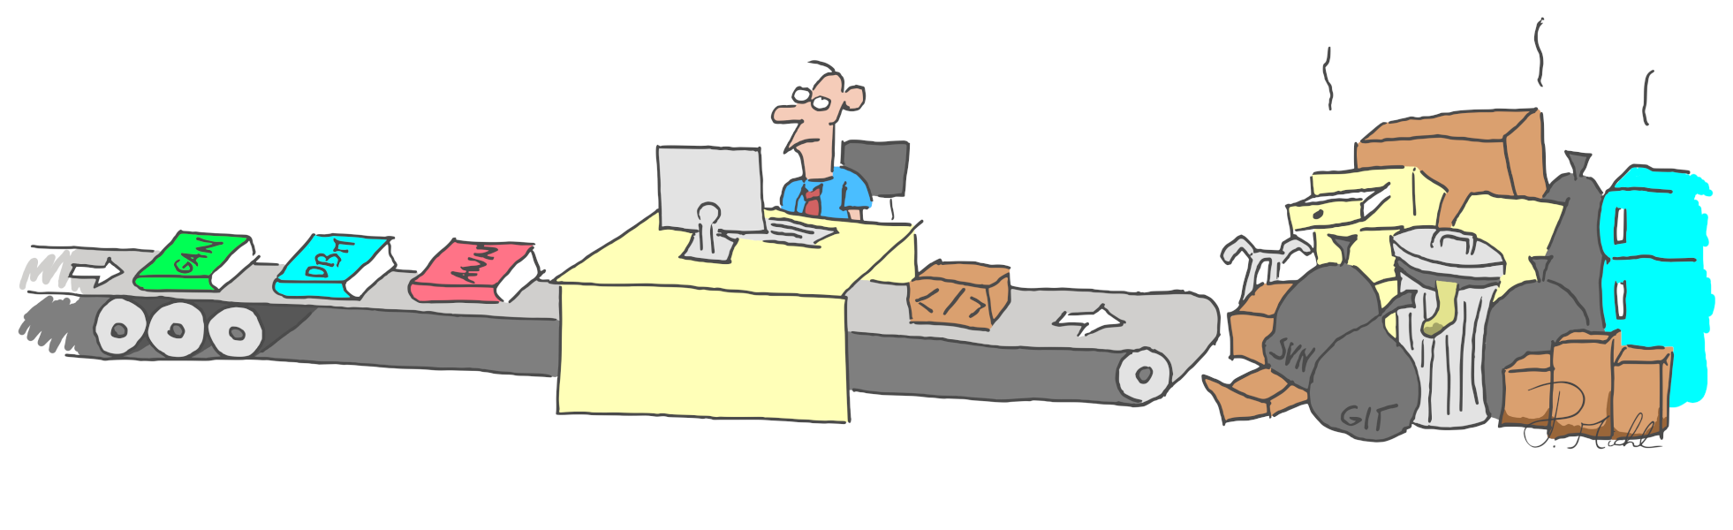
Thank you for your attention!

